Slide 1


PARK COLLEGE OF ENGINEERING AND TECHNOLOGY Kaniyur , Coimbatore Department of Computer science and engineering REAL TIME DROWSINESS DETECTION USING CASCADE OBJECT DETECTION AND YOLO ALGORITHM
INTERNAL GUIDE: TEAM MEMBERS:
Dr. V. Saranya B.E., M.Tech., PhD., ESWAEN G (712220104010)
HEAD OF THE DEPARTMENT / CSE RAJNISH KUMAR (712220104030)
SWETHA T (712220104050)
SWETHA R (712220104051)

Slide 2
OUTLINE
Introduction
Problem statement
Objective
Abstract
Literature survey
Inference from Literature Review
Existing system
Drawbacks
Architecture Diagram
Proposed system
Advantages
Modules
In build algorithm
Screen shots
Summary
Future Enhancement
References

Slide 3
INTRODUCTION
The word “Drowsy” looks very simple but it becomes more crucial in the condition when someone involves in performing jobs where deep concentration is an important factor like working in chemical factory or driving a heavy vehicle etc.
According to the report 2018 based on the road accidents in India presented by Ministry of Road Transport & Highway, disclose that 4, 67,044 accidents took place in states as well as in Union Territories.
Deep YOLO have shown great promise in driver drowsiness detection due to their ability to learn and extract features from complex visual data.
However, the accuracy of individual YOLO models can be limited due to overfitting, noise in the data, and other factors.
Further, the analysis of this report shows that 78% road crashes out of total were caused due driver’s inattention. Therefore, there is a need to develop a model that could avoid such a destructive road crashes and save the precious lives of mankind. Here, our proposed work satisfies these requirements

Slide 4
PROBLEM STATEMENT
Drowsy driving is a significant cause of accidents worldwide, leading to fatalities and injuries. Traditional methods of detecting drowsiness in drivers often rely on manual observations or simple sensors, which may not be reliable or timely enough to prevent accidents. To address this issue, there is a growing interest in developing real-time drowsiness detection systems using advanced computer vision techniques.
The goal of this project is to develop a robust real-time drowsiness detection system that can accurately identify signs of drowsiness in drivers and alert them to take necessary actions to prevent accidents. This system will utilize two key techniques: Cascade Object Detection and the YOLO (You Only Look Once) algorithm.
The Cascade Object Detection technique is widely used for its efficiency in detecting objects in images. By training a cascade classifier on a dataset of images containing various facial expressions and eye states, the system will be able to recognize specific patterns associated with drowsiness, such as drooping eyelids or closed eyes.
Additionally, the YOLO algorithm, known for its speed and accuracy in object detection tasks, will be employed to further enhance the system's performance. YOLO's ability to detect objects in real-time with high precision will enable the system to quickly identify signs of drowsiness as they occur, allowing for immediate intervention.

Slide 5
OBJECTIVE
The objective of this paper is to propose a deep YOLO models-based ensemble approach for driver drowsiness detection.
The proposed approach aims to improve the accuracy of driver drowsiness detection by combining multiple YOLO models that are trained on different subsets of the data.
The ensemble approach is designed to reduce the effects of noise and overfitting and increase the diversity of features learned by different models.
To describe the proposed deep YOLO models-based ensemble approach for driver drowsiness detection.
To evaluate the performance of the proposed approach on a public dataset of driver drowsiness videos. To compare the performance of the proposed approach with individual YOLO models. To demonstrate the effectiveness of the ensemble approach in improving the accuracy of driver drowsiness detection.

Slide 6
ABSTRACT
This proposed work has established drowsy detection as well as accident avoidance system based on the eye blink duration. Here, first the open and close state of eye are detected based on the eye aspect ratio (EAR). Further, the blink duration or count during the changes of eye state from open to close are analyzed. Driver drowsiness is one of the leading causes of road accidents globally, and early detection of drowsiness can help prevent accidents. In recent years , YOLO have been successfully used for driver drowsiness detection. However, the accuracy of individual YOLO models can be limited due to overfitting, noise in the data, and other factors.Then, it identifies the state of drowsiness, when blink duration becomes more than a certain limits and sends the alert message to the driver through the alarm.
Our developed system has shown the accuracy of 92.5% approx on yawning dataset.

Slide 7
LITERATURE SURVEY
TITLE | AUTHOR & YEAR | METHOD | MERITS | DEMERITS
A Framework for Detecting Driver Drowsiness Based on Eye Blinking Rate and Hand Gripping Pressure | Arju, Md Ashfakur Rahman, et al. 2020 | Haar Cascade Classifier | More accuracy | Need no decrease complexity of the model.
Detection of drowsy eyes using viola jones face detection algorithm | M.Kusuma Sri, P.Naga Divya, J.Vyshnavi, B.Tejaswini 2020 | Cascaded objection detection. | Fast detection | Accuracy of the model is low
Driver Drowsiness Classification Based on Eye Blink and Head Movement Features Using the k-NN Algorithm | Dreißig, Mariella, et al. 2020 | KNN algorithm | Fast detection | Need to improve the accuracy of the model

Slide 8
LITERATURE SURVEY
TITLE | AUTHOR & YEAR | METHOD | MERITS | DEMERITS
Driver Fatigue Detection Using Viola Jones and Principal Component Analysis | Fatima, Bahjat, et al. 2020 | SVM and Adaboost is 96.5% and 95.4% | Accuracy of the SVM and Adaboost is 96.5% and 95.4% respectively. | Need to improve the system performance.
Driver Drowsiness Detection Based on Joint Monitoring of Yawning, Blinking and Nodding | Ghourabi, Aicha, Haythem, 2020 | Cascade based eye joint monitoring | Eye state prediction is quite accuarte. | Need to decrease the operation time.

Slide 9
INFRENCE FROM LITERATURE REVIEW
The literature survey reveals that drowsiness detection systems in vehicles rely on indicators such as blinking rate and hand pressure values to assess the driver's state. When the blinking rate exceeds normal levels and hand pressure falls below a predefined threshold, the system identifies the driver as drowsy.
However, limitations arise when direct cues about the driver's condition are unavailable. Therefore, the primary objective of this study is to enhance driver drowsiness detection in vehicles by incorporating signals from a driver monitoring camera.

Slide 10
EXISTING SYSTEM
In the existing approaches, the cascaded objection algorithm has been utilized in order to extract the face and eyes in the Given input.
Driver drowsiness detection is a technique used to identify if a driver is experiencing drowsiness or fatigue while driving.
Drowsiness is a state of reduced alertness and impaired cognitive function that can lead to accidents, especially when driving.
Eye joints are used to find the state of eye. Based on joints Drowsiness is defined.

Slide 11
DRAWBACKS OF EXISTING SYSTEM
Limited Object Recognition: They can only detect objects they've been trained on. Detecting drowsiness relies on subtle cues like drooping eyelids or head position, which can be challenging to capture reliably with variations in facial features or lighting.
Accuracy Challenges: Variability in Appearance: These algorithms struggle with objects that appear differently due to: Pose: Objects in unusual positions might be missed. Lighting: Poor lighting conditions can obscure features. Occlusion: Partially hidden objects can be misinterpreted.
Background Interference: Busy backgrounds with features similar to the target object can lead to false positives (detecting objects that aren't there).

Slide 12
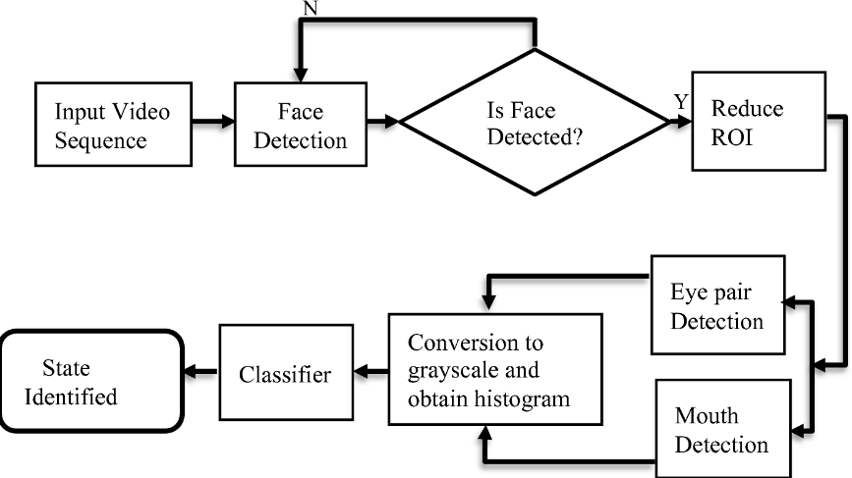
ARCHITECTURE DIAGRAM

Slide 13
PROPOSED SYSTEM
The proposed system for driver drowsiness detection is a deep YOLO models-based ensemble approach.
In the Proposed method, eye state is detected by cascade object detection method.
In our drowsiness detection system, we've implemented a feature that automatically sends an email to the vehicle owner when the driver is detected to be feeling drowsy.
This feature utilizes advanced image processing techniques to analyze real-time images captured inside the vehicle cabin, monitoring the driver's facial expressions and eye movements for signs of drowsiness.

Slide 14
PROPOSED SYSTEM
When such signs are detected, along with the timestamp of the occurrence, an automated email containing relevant images is generated and sent to the owner. This email serves as a proactive alert, enabling the owner to promptly address the situation and ensure the safety of the driver and others on the road.
By providing visual evidence along with the timestamp, the owner gains a clear understanding of the situation, facilitating informed decision-making and intervention strategies.
This integration of image analysis technology enhances the effectiveness of our drowsiness detection system, contributing to overall road safety and driver well-being

Slide 15
ADVANTAGE
Detection time is low
More accuracy.
Python is environment friendly, hence easy to implememented in any device.
Multiple work executed at same time
Better services to passengers.
Driver or conductor no need to shout always

Slide 16
MODULES
CAMERA:
A camera module for real-time drowsiness detection typically involves capturing video frames of the driver's face, analyzing facial features and movements and using algorithms to detect signs of drowsiness.This can include techniques like eye tracking, facial landmark detection, and machine learning models to classify drowsiness levels based on observed patterns..

Slide 17
OPENCV
OpenCV, or Open Source Computer Vision Library, is a powerful tool for real-time computer vision tasks.
In the drowsiness detection,we can use OpenCV along with other libraries like dlib or TensorFlow for facial landmark detection.
Once we have the landmarks, we can measure various facial features like eye aspect ratio (EAR) to determine if a person's eyes are closed for an extended period it indicates the drowsiness of the driver.
By continuously analyzing these features in real-time video streams we can detect drowsiness

Slide 18
MACHINE LEARNING
The YOLO (You Only Look Once) algorithm revolutionized object detection in computer vision by introducing a single neural network that predicts bounding boxes and class probabilities directly from full images in one evaluation .
It operates by dividing the image into a grid and predicting bounding boxes and class probabilities for each grid cell.
This is accomplished through a convolutional neural network (CNN) architecture, typically based on Darknet, which simultaneously predicts multiple bounding boxes and their corresponding class probabilities .
YOLO is used to accurately detect and classify objects in real-time applications efficiently.

Slide 19
LBPH- LOCAL BINARY PATTERN
Local Binary Pattern (LBP) is a simple yet very efficient texture operator which labels the pixels of an image by thresholding the neighborhood of each pixel and considers the result as a binary number.
Face Detection: It has the objective of finding the faces (location and size) in an image and probably extract them to be used by the face recognition algorithm.
Face Recognition: With the facial images already extracted, cropped, resized and usually converted to grayscale, the face recognition algorithm is responsible for finding characteristics which best describe the image.

Slide 20
IN BUILD ALGORITHM
YOLO Object Detection:
Apply YOLO object detection to identify drowsiness-related objects and behaviors, such as closed eyes or head nodding.
Obtain bounding boxes and confidence scores for detected objects.
Cascade Object Detection:
Apply cascade object detection to detect facial features associated with drowsiness, such as eyes and facial expressions.
Extract regions of interest (ROIs) containing the detected facial features.

Slide 21
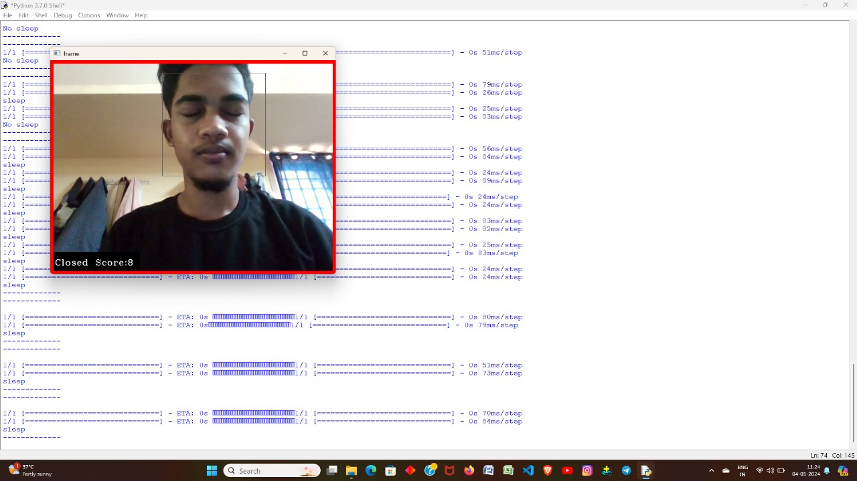
SCREEN SHOTS

Slide 22

SCREEN SHOTS

Slide 23

SCREEN SHOTS

Slide 24
SUMMARY
According to the report 2020 based on the road accidents in India presented by Ministry of Road Transport & Highway, disclose that 4, 77,044 accidents took place in states as well as in Union Territories.
The proposed method predict Drowsiness based on machine learning and cascade objection detection.
The Proposed method, achieves higher accuracy along with low operation time.

Slide 25
FUTURE ENHANCEMENT
Providing owners with weekly reports on drivers' behavior, including images of when they feel drowsy and the times they feel drowsy, is a proactive approach to ensuring road safety.
Analyzing this data can help improve driver performance and prevent potential accidents caused by drowsiness. It's a smart move towards better safety and efficiency.

Slide 26
REFERENCE
[1] Arju, Md Ashfakur Rahman, et al. "A Framework for Detecting Driver Drowsiness Based on Eye Blinking Rate and Hand Gripping Pressure." Proceedings of International Joint Conference on Computational Intelligence. Springer, Singapore, (2020).
[2] Anitha, J., G. Mani, and K. Venkata Rao. "Driver drowsiness detection using viola jones algorithm." Smart Intelligent Computing and Applications. Springer, Singapore, (2020). 583-592.
[3] Dreißig, Mariella, et al. "Driver Drowsiness Classification Based on Eye Blink and Head Movement Features Using the k-NN Algorithm." (2020) IEEE Symposium Series on Computational Intelligence (SSCI). IEEE, 2020
[4] Fatima, Bahjat, et al. "Driver Fatigue Detection Using Viola Jones and Principal Component Analysis." Applied Artificial Intelligence 34.6 (2020): 456-483.
[5] Ghourabi, Aicha, Haythem Ghazouani, and Walid Barhoumi. "Driver Drowsiness Detection Based on Joint Monitoring of Yawning, Blinking and Nodding." 2020 IEEE 16th International Conference on Intelligent Computer Communication and Processing (ICCP). IEEE, (2020).

Slide 27
THANK YOU !

